Slide 1
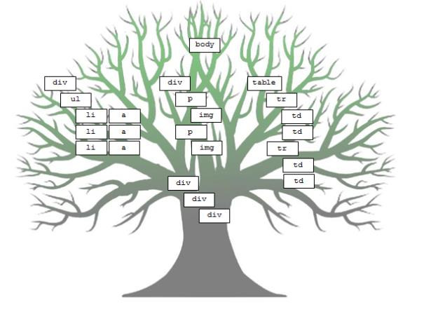
Document Object Model

Slide 2
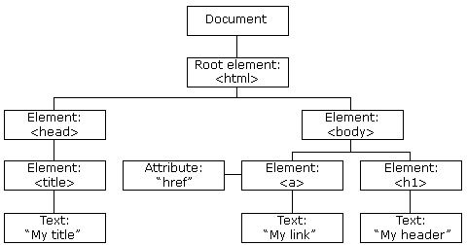
Document Object Model
When a web page is loaded, the browser creates a Document Object Model of the page.
The HTML DOM model is constructed as a tree of Objects:

Slide 3
What is the HTML DOM?
HTML DOM is part of W3C DOM (World Wide Web Consortium).
The HTML DOM is a standard object model and programming interface for HTML. It defines:
The HTML elements as objects
The properties of all HTML elements
The methods to access all HTML elements
The events for all HTML elements
In other words: The HTML DOM is a standard for how to get, change, add, or delete HTML elements.

Slide 4
Dynamic HTML
JavaScript can:
Change all the HTML elements
Change all the HTML attributes
Change all the CSS styles
Remove existing HTML elements and attributes
Add new HTML elements and attributes
React to all existing HTML events
Create new HTML events

Slide 5
The DOM Programming Interface
The HTML DOM can be accessed with JavaScript (and with other programming languages).
In the DOM, all HTML elements are defined as objects.
The programming interface is the properties and methods of each object.
A property is a value that you can get or set (like changing the content of an HTML element).
A method is an action you can do (like add or deleting an HTML element).
In the HTML DOM object model, the document object represents your web page.
If you want to access objects in an HTML page, you always start with accessing the document object.

Slide 6
Finding HTML Elements
Often, with JavaScript, you want to manipulate HTML elements.
To do so, you have to find the elements first:
by id
by tag name
by class name
by HTML object collections

Slide 7
Finding HTML Elements by Id
The easiest way to find HTML elements in the DOM, is by using the element id.
<!DOCTYPE html>
<html>
<body>
<p id="intro">Hello World!</p>
<p>This example demonstrates the <b>getElementById</b> method!</p>
<script>
x=document.getElementById("intro");
document.write("<p>The text from the intro paragraph: " + x.innerHTML + "</p>");
</script>
</body>
</html>

Slide 8
Finding HTML Elements by Tag Name
Get getElementsByTagName returns an array with all elements of a given type
<!DOCTYPE html>
<html>
<body>
<p>Hello World!</p>
<div id="main">
<p>The DOM is very useful.</p>
<p>This example demonstrates the <b>getElementsByTagName</b> method</p>
</div>
<script>
var x=document.getElementById("main");
var y=x.getElementsByTagName("p");
document.write('First paragraph inside "main" is ' + y[0].innerHTML);
</script>
</body>
</html>

Slide 9
Finding HTML Elements by Class Name
If you want to find all HTML elements with the same class name. Use this method:
document.getElementsByClassName("intro");
The example above returns a list of all elements with class="intro".
Finding elements by class name does not work in Internet Explorer 5,6,7, and 8.
The class attribute lets you assign to it one or more subtypes. These subtypes may then be used in CSS code for styling purposes, or by JavaScript code to make changes, or add behavior, to elements belonging to a particular subtype.

Slide 10
Finding HTML Elements by Object Collections
<!DOCTYPE html>
<html>
<body>
<form id="frm1" action="form_action.asp">
First name: <input type="text" name="fname" value="Donald"><br>
Last name: <input type="text" name="lname" value="Duck"><br>
<input type="submit" value="Submit">
</form>
<p>Click the "Try it" button to return the value of each element in the form.</p>
<p id="demo"></p>
<button onclick="myFunction()">Try it</button>
<script>
function myFunction()
{
var x = document.getElementById("frm1");
var txt = "";
for (var i=0;i<x.length;i++)
{
txt = txt + x.elements[i].value + "<br>";
}
document.getElementById("demo").innerHTML=txt;
}
</script>
</body>
</html>

Slide 11
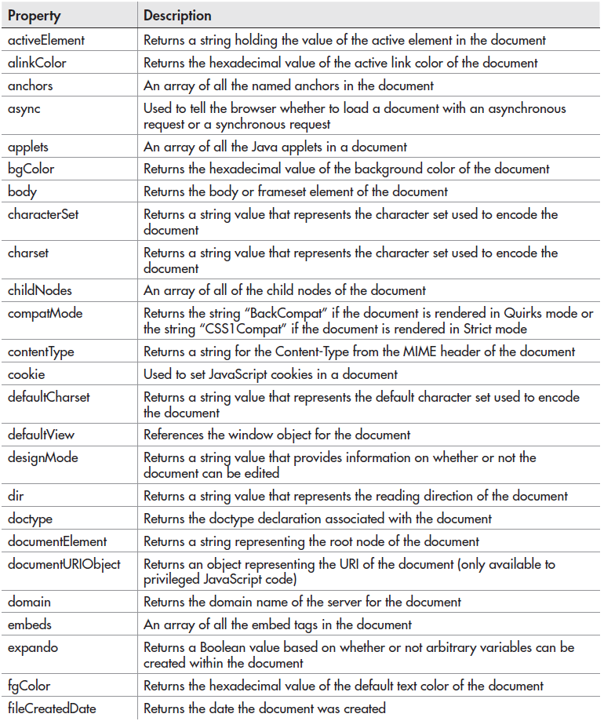

Slide 12
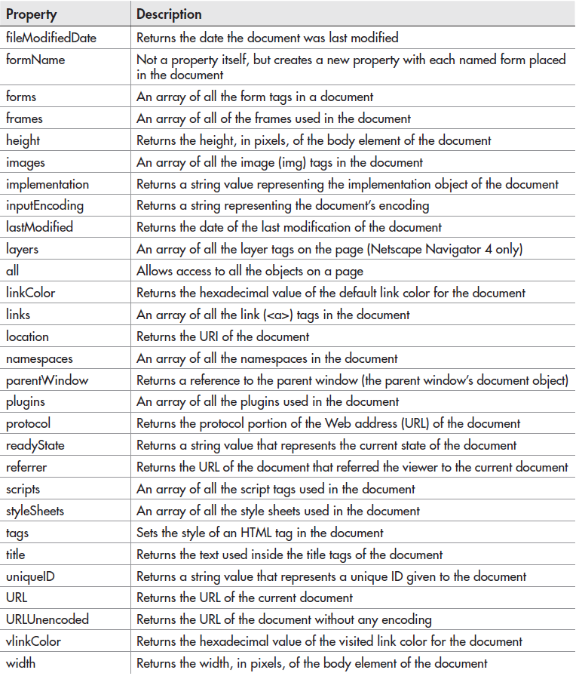

Slide 13
Changing HTML Elements
document.write() can be used to write directly to the HTML output stream.
To change the content of an HTML element, use this syntax:
document.getElementById(id).innerHTML=new HTML
To change the value of an HTML attribute, use this syntax:
document.getElementById(id).attribute=new value

Slide 14
Example: Changing Attribute Value
This example changes the value of the src attribute of an <img> element:
<!DOCTYPE html>
<html>
<body>
<img id="image" src="smiley.gif" width="160" height="120">
<script>
document.getElementById("image").src="landscape.jpg";
</script>
<p>The original image was smiley.gif, but the script changed it to landscape.jpg</p>
</body>
</html>

Slide 15
Changing HTML Style
To change the style of an HTML element, use this syntax:
document.getElementById(id).style.property=new style
The following example dynamically changes visiblity of a paragraph:
<!DOCTYPE html>
<html>
<body>
<p id="p1">
This is a text.
This is a text.
This is a text.
This is a text.
</p>
<input type="button" value="Hide text" onclick="document.getElementById('p1').style.visibility='hidden'">
<input type="button" value="Show text" onclick="document.getElementById('p1').style.visibility='visible'">
</body>
</html>

Slide 16
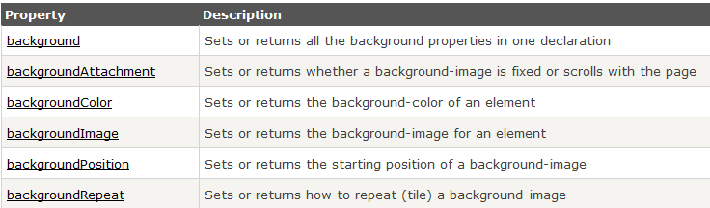
Style: Background properties

Slide 17
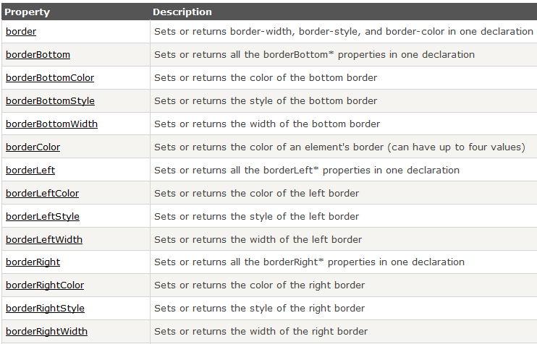
Style: Border/Outline properties 1

Slide 18
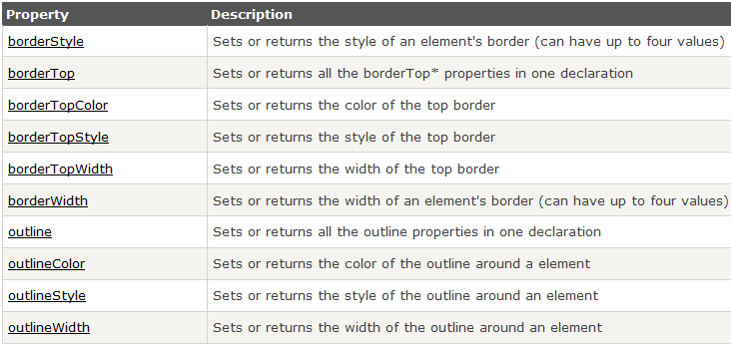
Style: Border/Outline properties 2

Slide 19
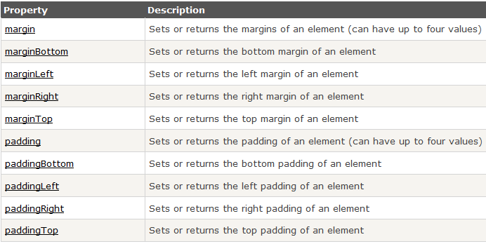
Style: Margin/Padding properties

Slide 20
Style: Margin/Padding properties

Slide 21
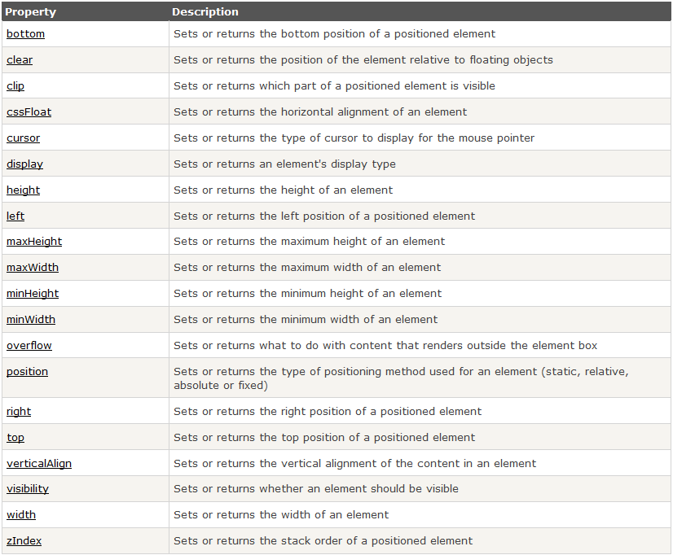
Style: Positioning/Layout properties

Slide 22
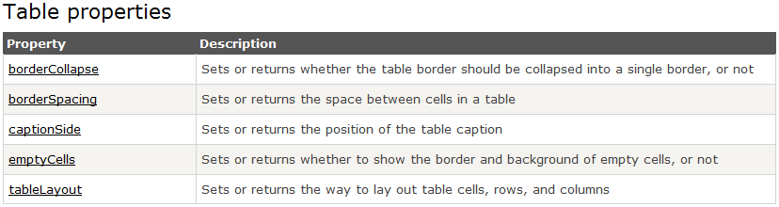
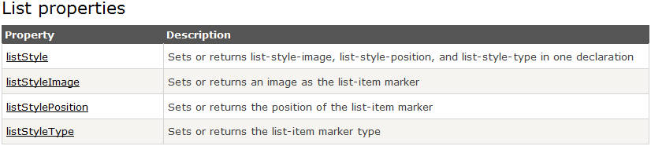
Style: Table & List Properties

Slide 23
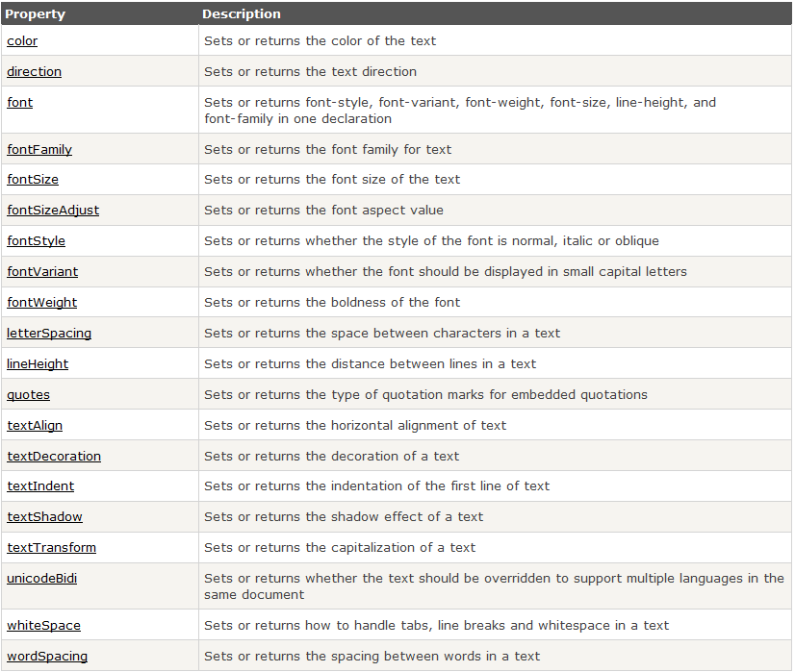
Style: Text properties

Slide 24

DOM Nodes
According to the W3C HTML DOM standard, everything in an HTML document is a node:
The entire document is a document node
Every HTML element is an element node
The text inside HTML elements are text nodes
Every HTML attribute is an attribute node
All comments are comment nodes

Slide 25
Navigating Between Nodes
You can use the following node properties to navigate between nodes with JavaScript:
parentNode
childNodes[nodenumber]
firstChild
lastChild
nextSibling
previousSibling

Slide 26
Example: Accessing a Child Node
<html> <body> <p id="intro">Hello World!</p> <script> var txt=document.getElementById("intro").childNodes[0].nodeValue; document.write(txt); </script> </body> </html>
We can also use firstChild.nodeValue to get the same effect.

Slide 27
Creating New HTML Elements
To add a new element to the HTML DOM, you must create the element (element node) first, and then append it to an existing element.
<!DOCTYPE html>
<html>
<body>
<div id="div1">
<p id="p1">This is a paragraph.</p>
<p id="p2">This is another paragraph.</p>
</div>
<script>
var para=document.createElement("p");
var node=document.createTextNode("This is new.");
para.appendChild(node);
var element=document.getElementById("div1");
element.appendChild(para);
</script>
</body>
</html>

Slide 28
insertBefore()
The appendChild() method in the previous example, appended the new element as the last child of the parent.
If you don't want that you can use the insertBefore() method:
<div id="div1"> <p id="p1">This is a paragraph.</p> <p id="p2">This is another paragraph.</p> </div> <script> var para=document.createElement("p"); var node=document.createTextNode("This is new."); para.appendChild(node); var element=document.getElementById("div1"); var child=document.getElementById("p1"); element.insertBefore(para,child); </script>

Slide 29
Removing Existing HTML Elements
To remove an HTML element, you must know the parent of the element:
<div id="div1"> <p id="p1">This is a paragraph.</p> <p id="p2">This is another paragraph.</p> </div> <script> var parent=document.getElementById("div1"); var child=document.getElementById("p1"); parent.removeChild(child); </script>

Slide 30
Replacing HTML Elements
To replace an element to the HTML DOM, use the replaceChild() method:
<div id="div1"> <p id="p1">This is a paragraph.</p> <p id="p2">This is another paragraph.</p> </div> <script> var para=document.createElement("p"); var node=document.createTextNode("This is new."); para.appendChild(node); var parent=document.getElementById("div1"); var child=document.getElementById("p1"); parent.replaceChild(para,child); </script>

